Slide 1
Jackson

Slide 2
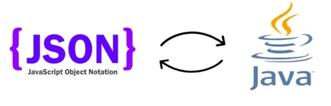

Jackson
Jackson is a simple java-based library to serialize java objects to JSON and vice versa.
Jackson library is open source and is free to use.
Jackson creates a clean and compact JSON results which is easy to read.
The Jackson library is composed of three components: Jackson Databind, Core, and Annotation.
Download Jackson jars from http://www.java2s.com/Code/Jar/j/Downloadjacksonall190jar.htm
You can include the dependency in pom.xml.

Slide 3
ObjectMapper
ObjectMapper is the main actor class of Jackson library. ObjectMapper class provides functionality for reading and writing JSON, either to and from basic POJOs (Plain Old Java Objects).
ObjectMapper class has two important methods:
void writeValue(File resultFile, Object value) - Method that can be used to serialize any Java type as JSON output, written to File provided.
T readValue(File src, Class<T> valueType) - Method to deserialize JSON content from given file into given Java type.

Slide 4
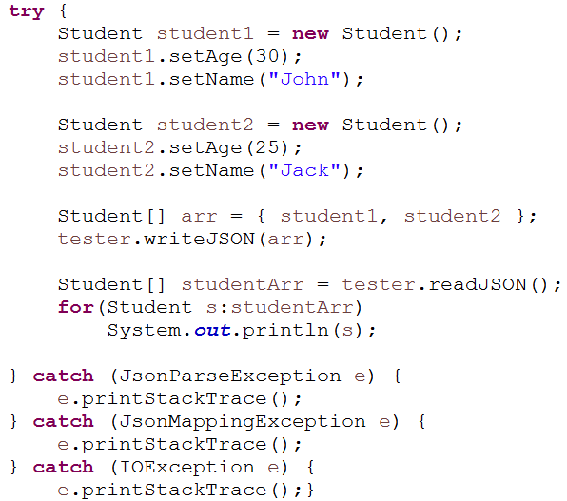
Demo
Demonstrate to write an array of student objects into json file and read the json file using Jackson
Code Snippet

Slide 5
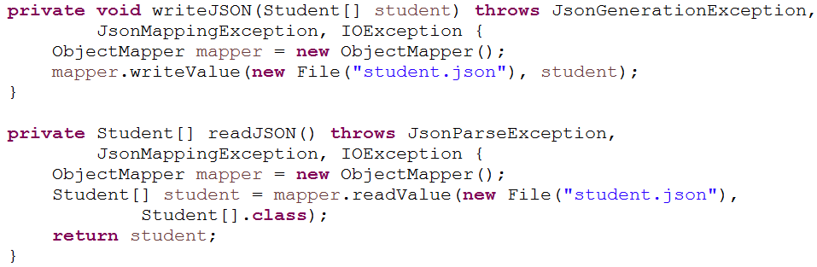

Demo…
student.json
Output

Slide 6

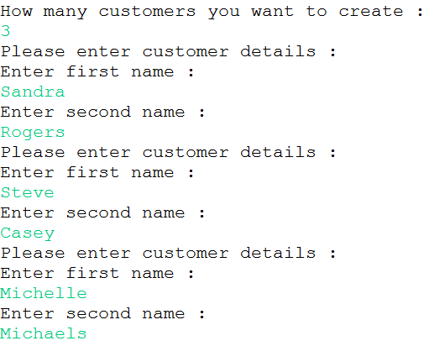


Presenting the Use case on Jackson
Display the menu to user.
User selects option 1, user will be asked how many objects you want to create. User can make the entries and it should be added in the json file.
User selects option 2 , it should display the JSON file data.
User selects option 3, it should exit the application.

